Slide 1
PointFusion: Deep Sensor Fusion for 3D Bounding Box Estimation
By - Vasu Dhull

Slide 2
Introduction
As 3D object detection is crucial for advanced applications such as autonomous driving, robotics, and augmented reality. This paper present a SoA in that field.
This paper deals with the detection of 3D objects and their 3D point cloud information.
The datasets that are used in this paper are KITTI and SUN-RGBD.
This paper aims in getting the information of all the 6DoF poses along with the 3D bounding box of the point of interest in the scene.

Slide 3
Dataset
KITTI :
Captured using cameras and LiDAR sensors mounted on a vehicle driving through a mid-size city, rural areas, and on highways, the dataset reflects a wide range of real-world driving conditions and environments.
The dataset includes high-resolution RGB images and 3D point clouds. It contains precise annotations for 3D bounding boxes, object classes such as cars, pedestrians, and cyclists.
SUN-RGBD:
The SUN RGB-D dataset includes a wide variety of indoor environments such as homes, offices, and public spaces. It contains both RGB images and depth data.
The dataset is meticulously annotated with 3D bounding boxes, object labels, and pixel-level segmentations.

Slide 4
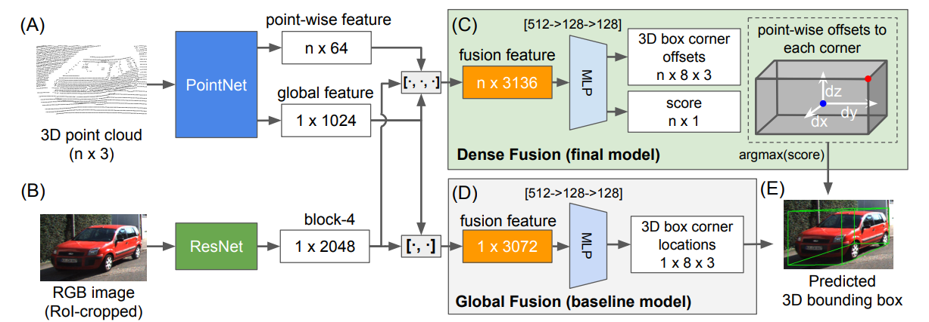
Architecture

Slide 5


Point Fusion Model
A SoA 2D model to get the cropped out image.
3D cloud is set to get:
Variant of Point Net Network that extracts point features.
No Batch Normalisation
Spatial Transform Network
2. A CNN that extracts image appearance features.
3. A Fusion Network to put bounding boxes.
A Vanila Global Architecture (L = ∑ smoothL1(x∗_i, x_i) + L_stn)
Novel Dence Architecture

Slide 6
Results
Metric - AP3D (3D object detection average precision metric)
The dense architecture consistently outperforms the global architecture in terms of performance metrics.This superiority is attributed to the use of input points as spatial anchors, indicating that densely sampling input points improves spatial accuracy and overall model performance.
The unsupervised scoring function performs slightly better for models focused on car detection and all-category models.This suggests that relying on a self-learned scoring function tailored to the specific task (unsupervised) yields better results compared to using a hand-picked proxy objective (supervised).
Fusion of lidar and image information consistently improves performance across different categories.
The model's performance remains stable with 300-500 input points per region of interest (RoI) but degrades significantly below 200 points.This highlights the model's dependency on sufficient input points to maintain high 3D detection performance.

